Slide 1
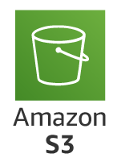
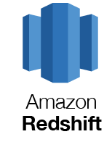





Architecture of the Pipeline
Use lambda function to load the data into intermediate bucket (Zillow-project-intermediate-bucket)
Use lambda function to load the data into transformed bucket (Zillow-project-transformed-bucket)
Load to Amazon Redshift in table format
Extract data from Zillow Rapid API
Load to landing bucket (Zillow-project-bucket)
Load to intermediate bucket (Zillow-project-intermediate-bucket)
Load to final bucket in csv format (Zillow-project-transformed-bucket)

Slide 2
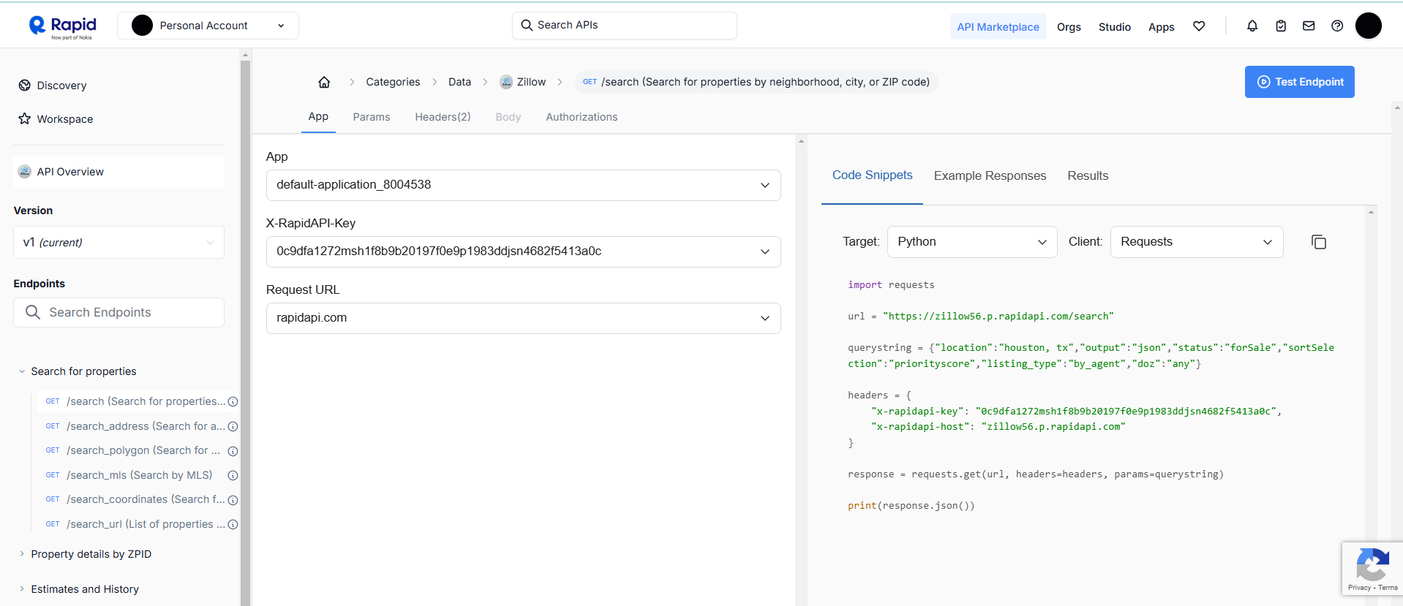
Rapid API

Slide 3
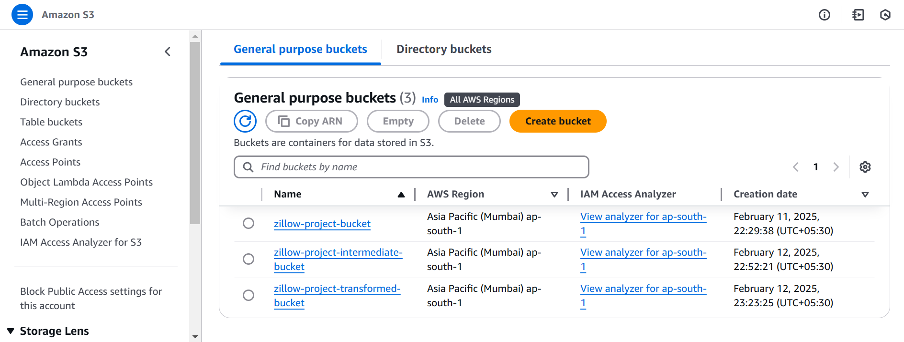
AWS S3 Buckets to store the data

Slide 4
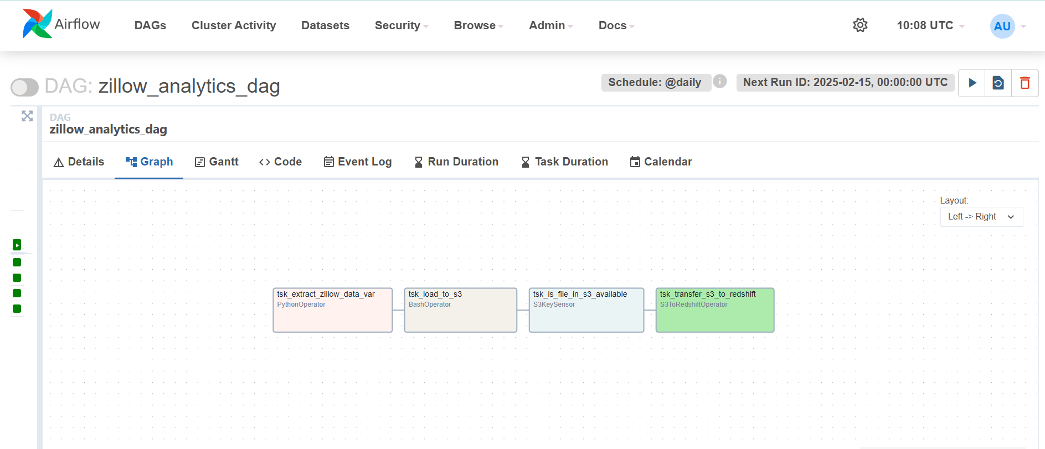
Airflow DAG

Slide 5
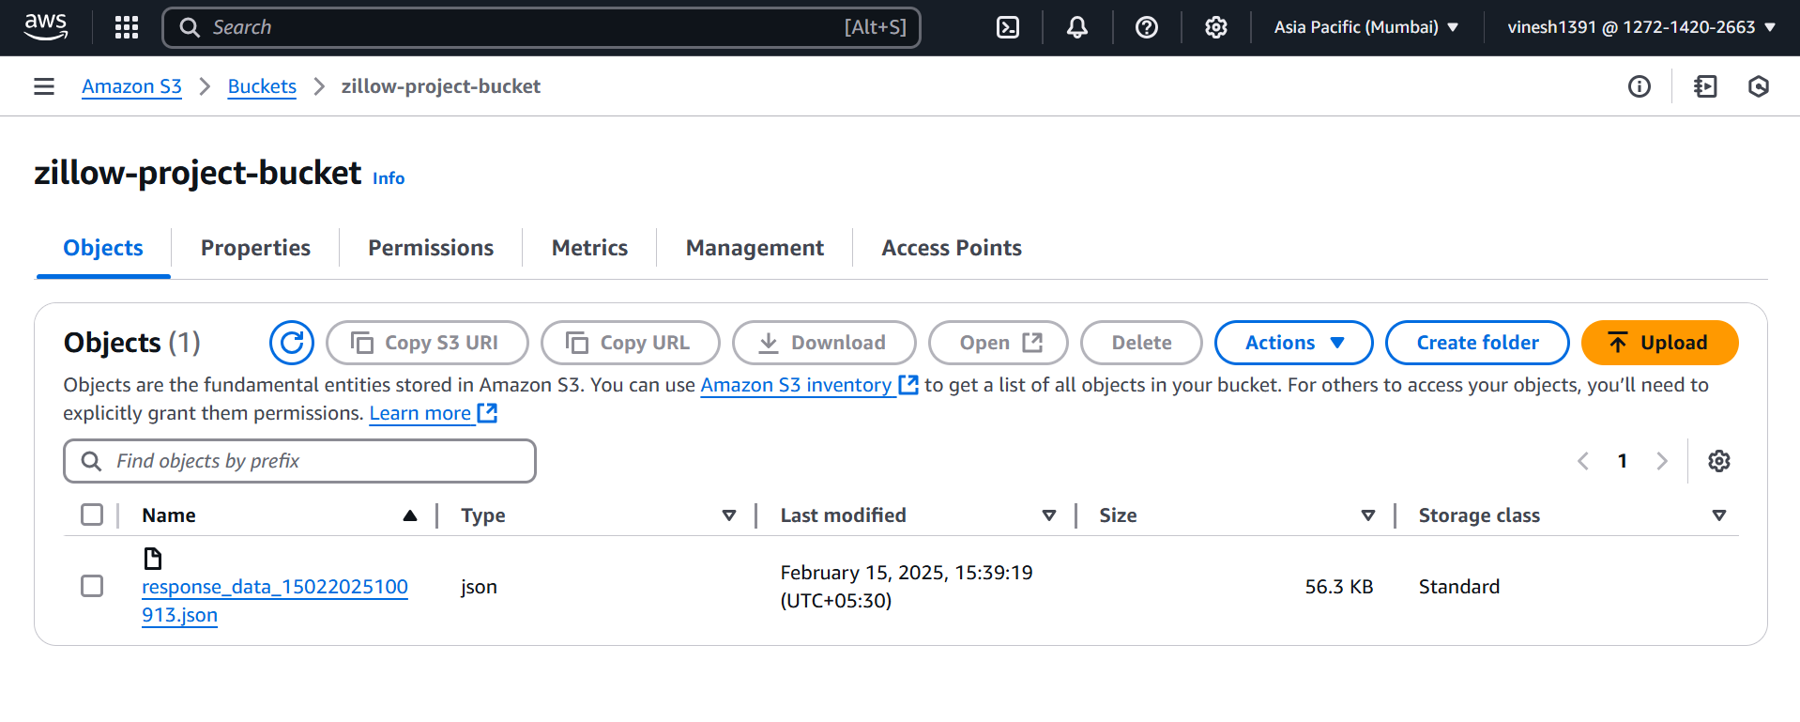
Landing S3 Bucket

Slide 6
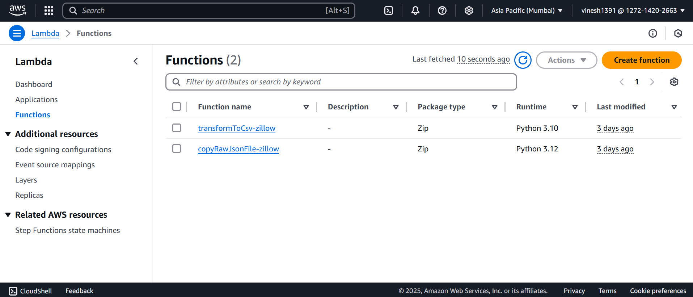
Lambda Functions

Slide 7
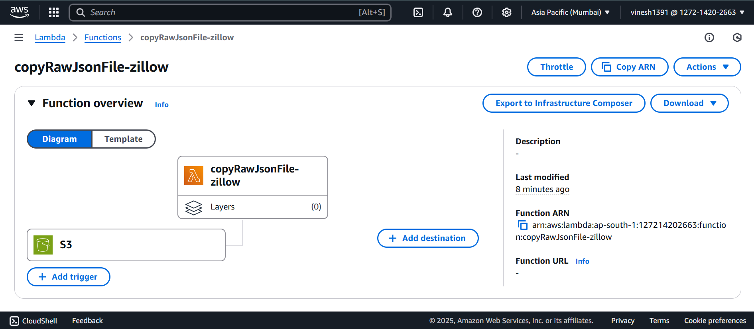
Lambda Function to load into intermediate S3 Bucket

Slide 8
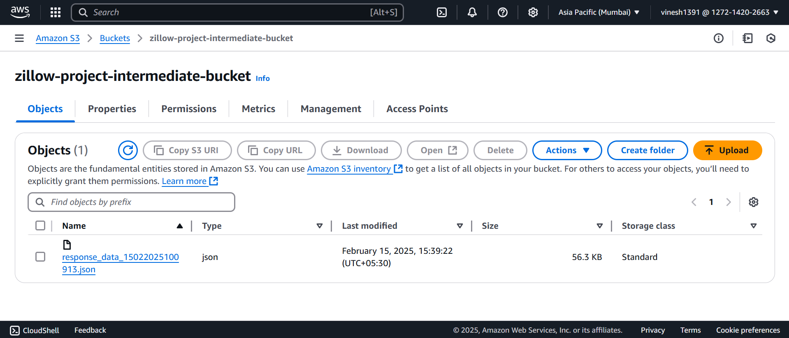
Intermediate S3 Bucket

Slide 9
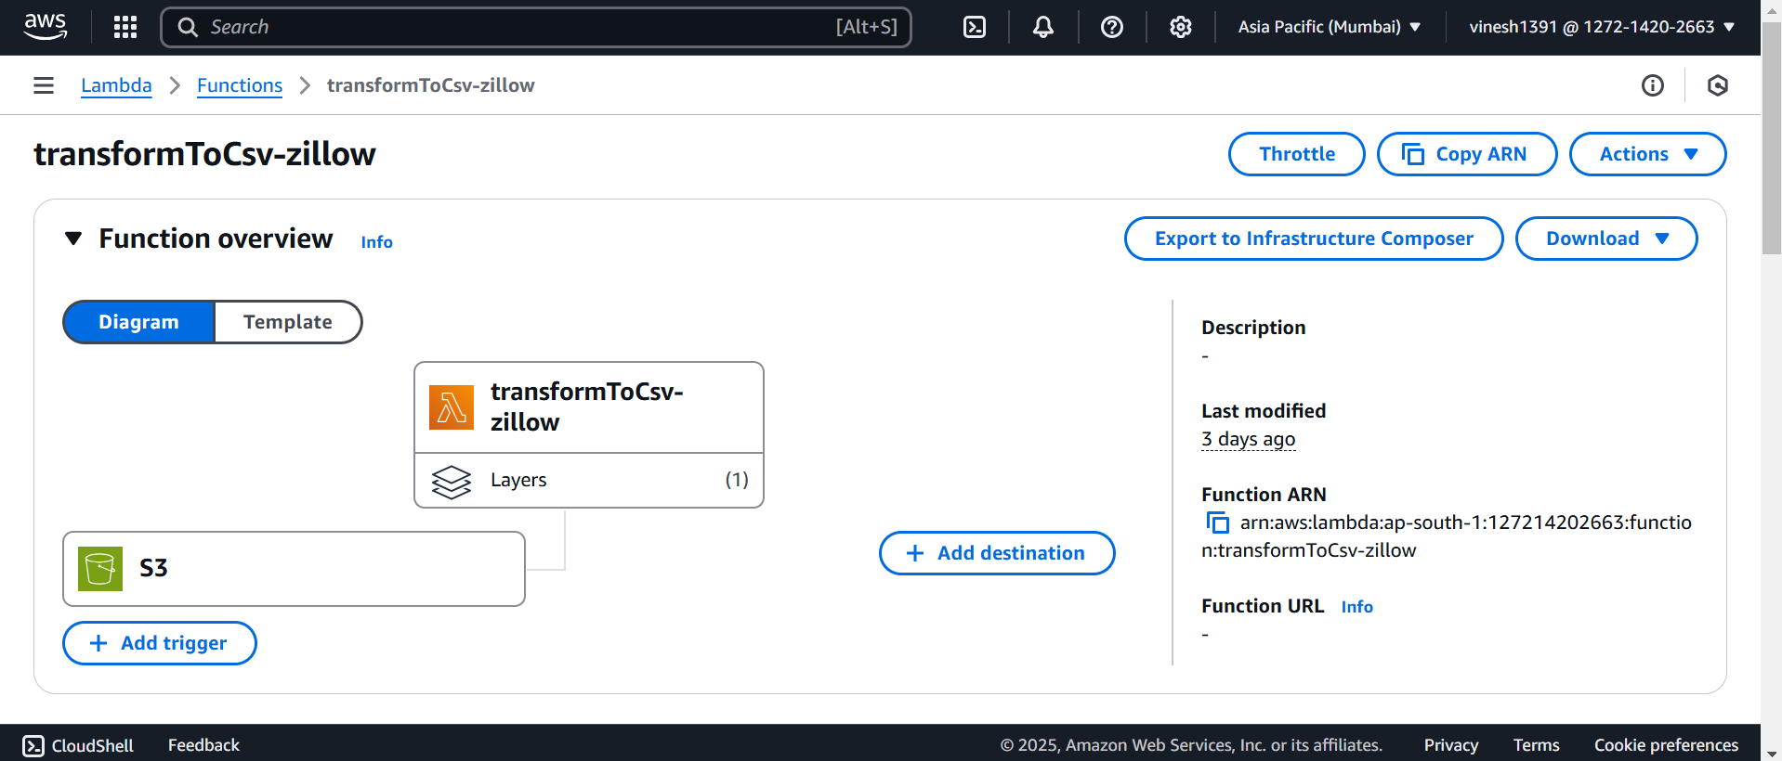
Lambda Function to load into transformed S3 Bucket

Slide 10
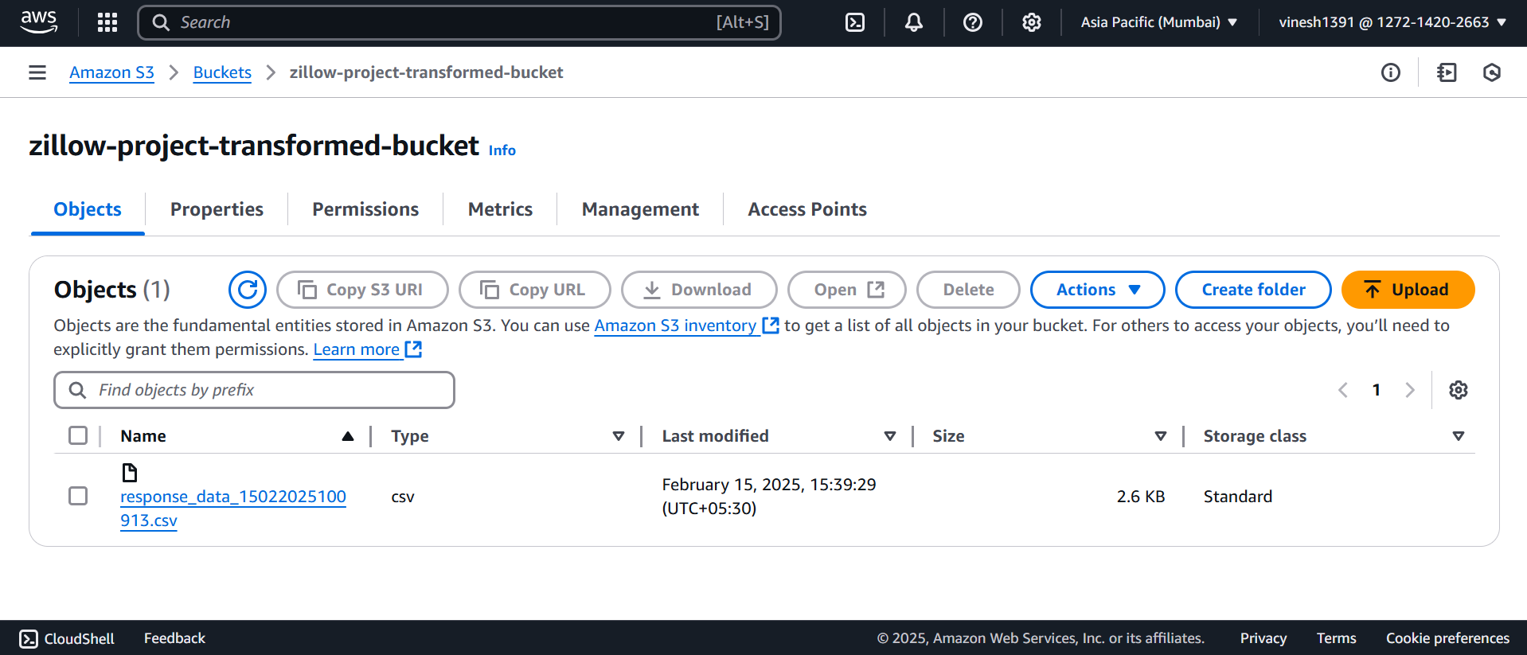
Transformed S3 Bucket

Slide 11
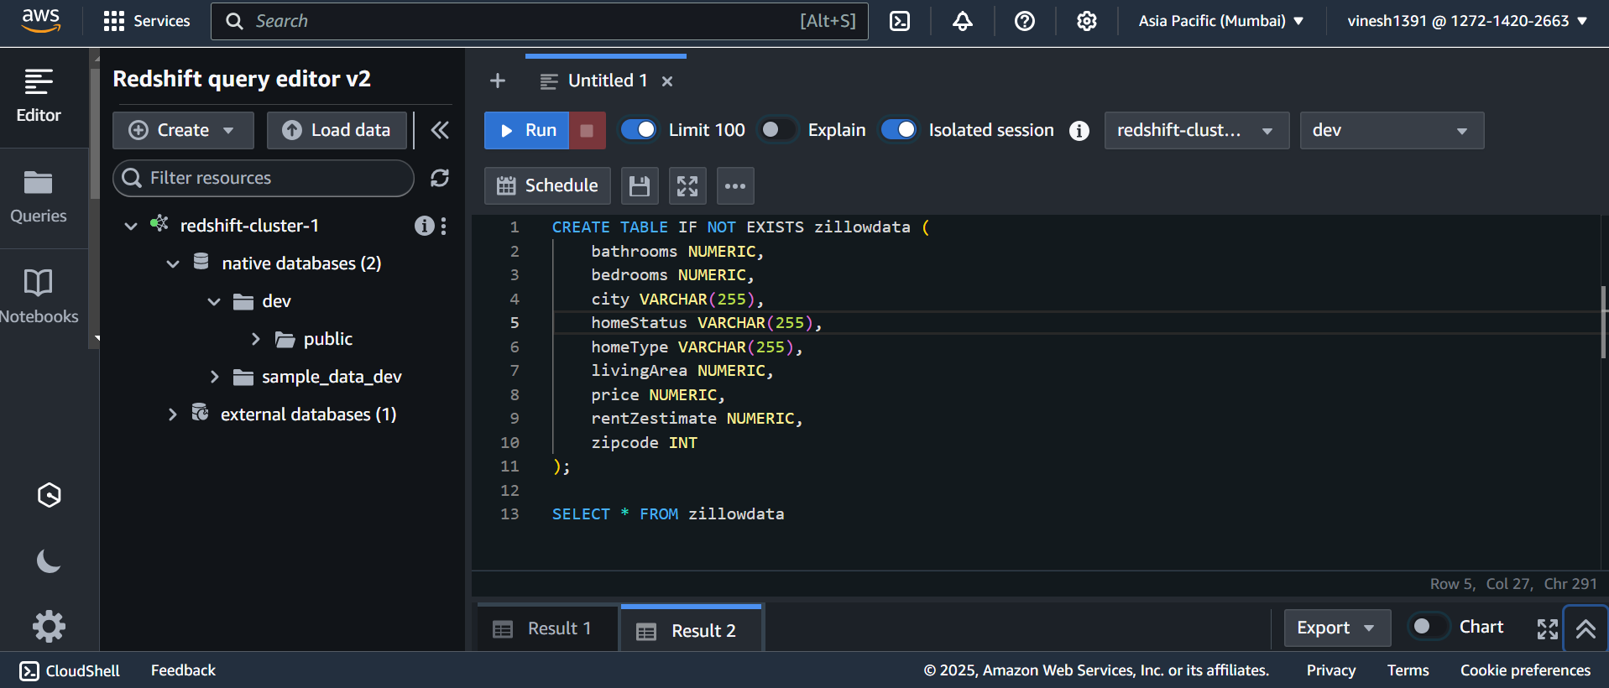
Creating Redshift Cluster

Slide 12
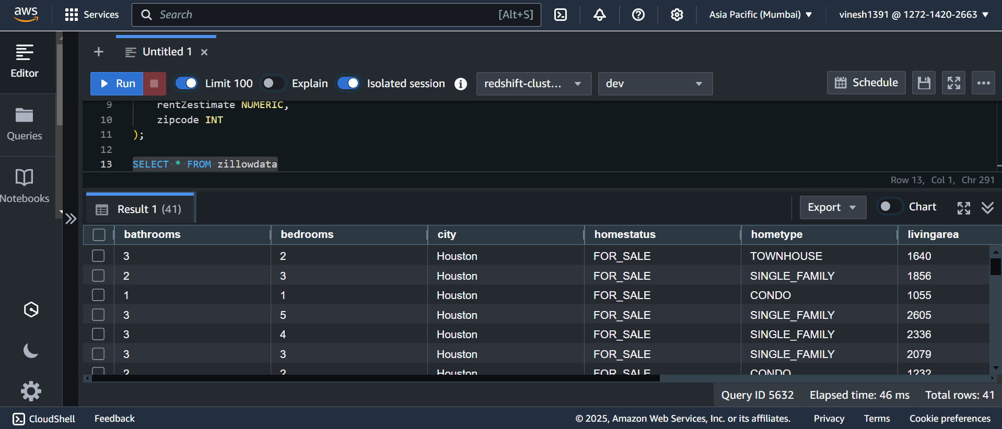
Data Loaded to Redshift

